Slide 1
Principles of Virtualization
Unit-I Basics of Virtualization

Slide 2
Principles of Virtualization
Understanding Virtualization
Introduction to Virtualization :
In computing, virtualization is a broad term that refers to the abstraction of computer resources. Virtualization hides the physical characteristics of computing resources from their users. This includes making a single physical resource (such as a server, an operating system, an application, or storage device) appear to function as multiple virtual resources; it can also include making multiple physical resources (such as storage devices or servers) appear as a single virtual resource.

Slide 3
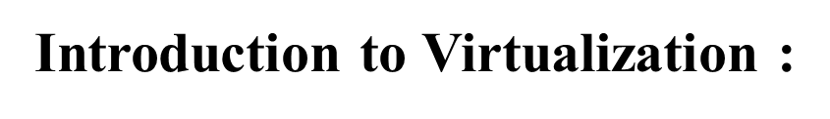
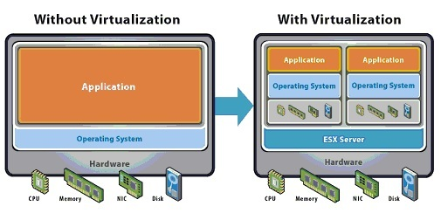
Principles of Virtualization
Understanding Virtualization

Slide 4
Principles of Virtualization
Understanding Virtualization
What is Virtualization?
Virtualization is the process of running a virtual instance of a computer system in a layer abstracted from the actual hardware. Most commonly, it refers to running multiple operating systems on a computer system simultaneously. To the applications running on top of the virtualized machine, it can appear as if they are on their own dedicated machine, where the operating system, libraries, and other programs are unique to the guest virtualized system and unconnected to the host operating system which sits below it

Slide 5
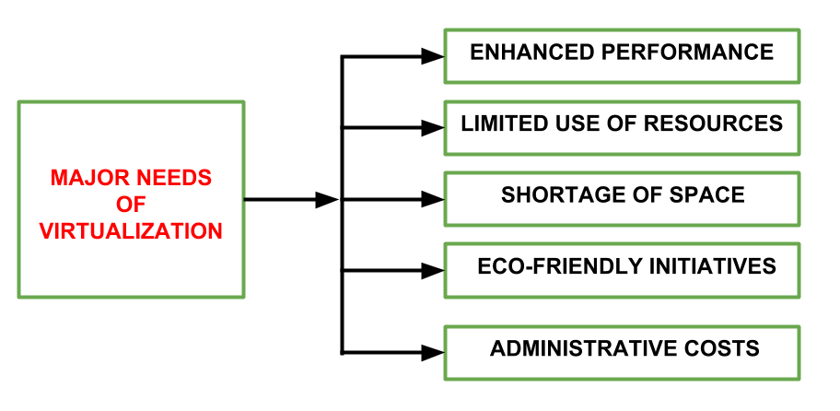
Principles of Virtualization
Understanding Virtualization
Need of Virtualization
There are five major needs of virtualization which are described below:

Slide 6
Principles of Virtualization
Understanding Virtualization
Need of Virtualization
1. ENHANCED PERFORMANCE- Currently, the end user system i.e. PC is sufficiently powerful to fulfill all the basic computation requirements of the user, with various additional capabilities which are rarely used by the user. Most of their systems have sufficient resources which can host a virtual machine manager and can perform a virtual machine with acceptable performance so far.

Slide 7
Principles of Virtualization
Understanding Virtualization
Need of Virtualization
2. LIMITED USE OF HARDWARE AND SOFTWARE RESOURCES- The limited use of the resources leads to under-utilization of hardware and software resources. As all the PCs of the user are sufficiently capable to fulfill their regular computational needs that’s why many of their computers are used often which can be used 24/7 continuously without any interruption. The efficiency of IT infrastructure could be increase by using these resources after hours for other purposes. This environment is possible to attain with the help of Virtualization.

Slide 8
Principles of Virtualization
Understanding Virtualization
Need of Virtualization
3. SHORTAGE OF SPACE- The regular requirement for additional capacity, whether memory storage or compute power, leads data centers raise rapidly. Companies like Google, Microsoft and Amazon develop their infrastructure by building data centers as per their needs. Mostly, enterprises unable to pay to build any other data center to accommodate additional resource capacity. This heads to the diffusion of a technique which is known as server consolidation.

Slide 9
Principles of Virtualization
Understanding Virtualization
Need of Virtualization
4. ECO-FRIENDLY INITIATIVES- At this time, corporations are actively seeking for various methods to minimize their expenditures on power which is consumed by their systems. Data centers are main power consumers and maintaining a data center operations needs a continuous power supply as well as a good amount of energy is needed to keep them cool for well-functioning. Therefore, server consolidation drops the power consumed and cooling impact by having a fall in number of servers. Virtualization can provide a sophisticated method of server consolidation..

Slide 10
Principles of Virtualization
Understanding Virtualization
Need of Virtualization
5. ADMINISTRATIVE COSTS- Furthermore, the rise in demand for capacity surplus, that convert into more servers in a data center, accountable for a significant increase in administrative costs. Hardware monitoring, server setup and updates, defective hardware replacement, server resources monitoring, and backups are included in common system administration tasks. These are personnel-intensive operations. The administrative costs is increased as per the number of servers. Virtualization decreases number of required servers for a given workload, hence reduces the cost of administrative employees.

Slide 11
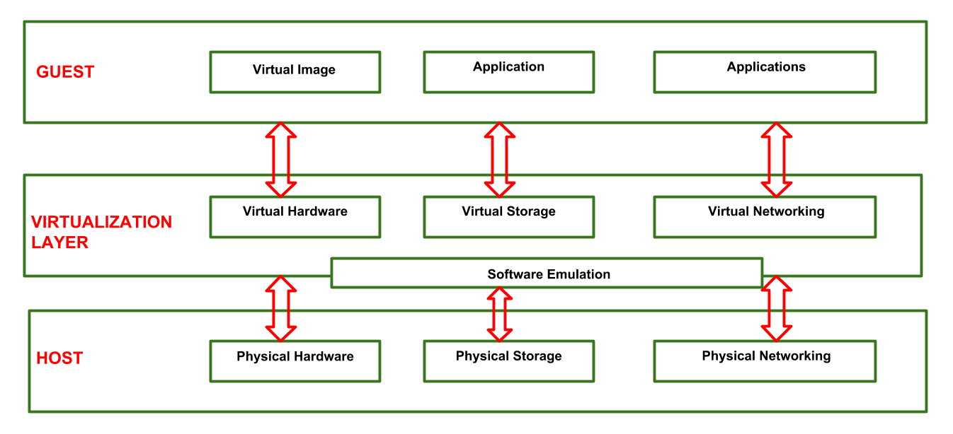
Principles of Virtualization
Understanding Virtualization
VIRTUALIZATION REFERENCE MODEL-

Slide 12
Principles of Virtualization
Understanding Virtualization
VIRTUALIZATION REFERENCE MODEL-
1. GUEST: The guest represents the system component that interacts with the virtualization layer rather than with the host, as would normally happen. Guests usually consist of one or more virtual disk files, and a VM definition file. Virtual Machines are centrally managed by a host application that sees and manages each virtual machine as a different application.

Slide 13
Principles of Virtualization
Understanding Virtualization
VIRTUALIZATION REFERENCE MODEL-
2. HOST: The host represents the original environment where the guest is supposed to be managed. Each guest runs on the host using shared resources donated to it by the host. The operating system, works as the host and manages the physical resource management, and the device support.

Slide 14
Principles of Virtualization
Understanding Virtualization
VIRTUALIZATION REFERENCE MODEL-
3. VIRTUALIZATION LAYER: The virtualization layer is responsible for recreating the same or a different environment where the guest will operate. It is an additional abstraction layer between a network and storage hardware, computing, and the application running on it. Usually it helps to run a single operating system per machine which can be very inflexible compared to the usage of virtualization.

Slide 15
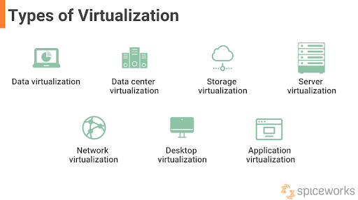
Principles of Virtualization
Understanding Virtualization
Types of Virtualization:
Server Virtualization.
Application Virtualization.
Network Virtualization.
Storage Virtualization.
Hardware Virtualization.

Slide 16
Principles of Virtualization
Understanding Virtualization
Types of Virtualization:
1. Data virtualization:
Almost all businesses these days run on data. They have a horde of data from various applications in various file formats, stored on on-site hardware and software systems or in the cloud. Data virtualization allows companies to approach data dynamically and compile it from various sources. It allows the ready adaptation and modification of data from new sources.
Data virtualization tools integrate the systems that store data and the applications that access it. When a request or query from an application is raised, the layer accesses and provides answers available at different systems. Data virtualization ensures that data access is universal, thereby boosting organization-wide resilience.

Slide 17
Principles of Virtualization
Understanding Virtualization
Types of Virtualization:
2. Data center virtualization
Data center virtualization simplifies the provisioning and hosting of several virtualized data centers on the same physical infrastructure. Since the same data center can be used by different applications and organizations at once, its virtualization aids in optimizing resource and infrastructure utilization while lowering the capital and operating expenses of data centers.
Moreover, with virtual data centers, a business can easily reproduce a full data center environment without having to invest in infrastructure hardware of any kind.

Slide 18
Principles of Virtualization
Understanding Virtualization
Types of Virtualization:
3. Storage virtualization
Storage virtualization proves to be extremely beneficial in case of host failure. Since physical storage from several network storages is merged into one and controlled via a single primary storage, it ensures that the data is safe and uncompromised. It also equips these storages with enhanced capabilities such as replication and disaster recovery, thereby allowing certain IT operations related to storage (partition and protection) to be more flexible.

Slide 19
Principles of Virtualization
Understanding Virtualization
Types of Virtualization:
4. Server virtualization
As discussed earlier, server virtualization allows maximum usage of existing physical servers by creating several virtual environments that can work independently and simultaneously. It aims to boost resource sharing, consumption, and capacity for future growth, without having the user tied up in intricate server resources.
Through server virtualization, organizations can improve IT efficiency, decrease operating expenses, allocate workload effectively, and enhance application performance.

Slide 20
Principles of Virtualization
Understanding Virtualization
Types of Virtualization:
5. Network virtualization
Like all other virtualizations, the goal behind network virtualization is to break down the complexity of a network into manageable components. A network’s bandwidth is divided into several channels and then assigned to the server and devices in real time. In the telecommunications sector, it is customary to virtualize networks to reduce the number of physical components, such as switches, routers, servers, cables, and hubs, which is crucial to construct independent networks.

Slide 21
Principles of Virtualization
Understanding Virtualization
Types of Virtualization:
6. Desktop virtualization
Instead of virtualizing a server, desktop virtualization isolates the primary desktop environment from other desktop-using devices. It simplifies the simultaneous addition of security protocols and system updates across multiple virtual desktops.
Virtualizing a desktop can be done in two ways. Through virtual desktop infrastructure or VDI, users can access a wide range of OS without installing them on any device. This is achieved by having the central server run and stream multiple desktops on the virtual machines. The second method is to execute a hypervisor on a local computer, allowing users to run one or more additional operating systems on the same machine.

Slide 22
Principles of Virtualization
Understanding Virtualization
Types of Virtualization:
7. Application virtualization
IT organizations employ several applications, and it is not entirely feasible to install all these applications on all desktops for users. Virtualized software provides the same user experience as an installed app on a physical machine. Since the application is on a centralized server, virtualizing helps users access it even if it is incompatible with their device’s operating system. It is through application virtualization that Windows applications can run on Linux OS.

Slide 23
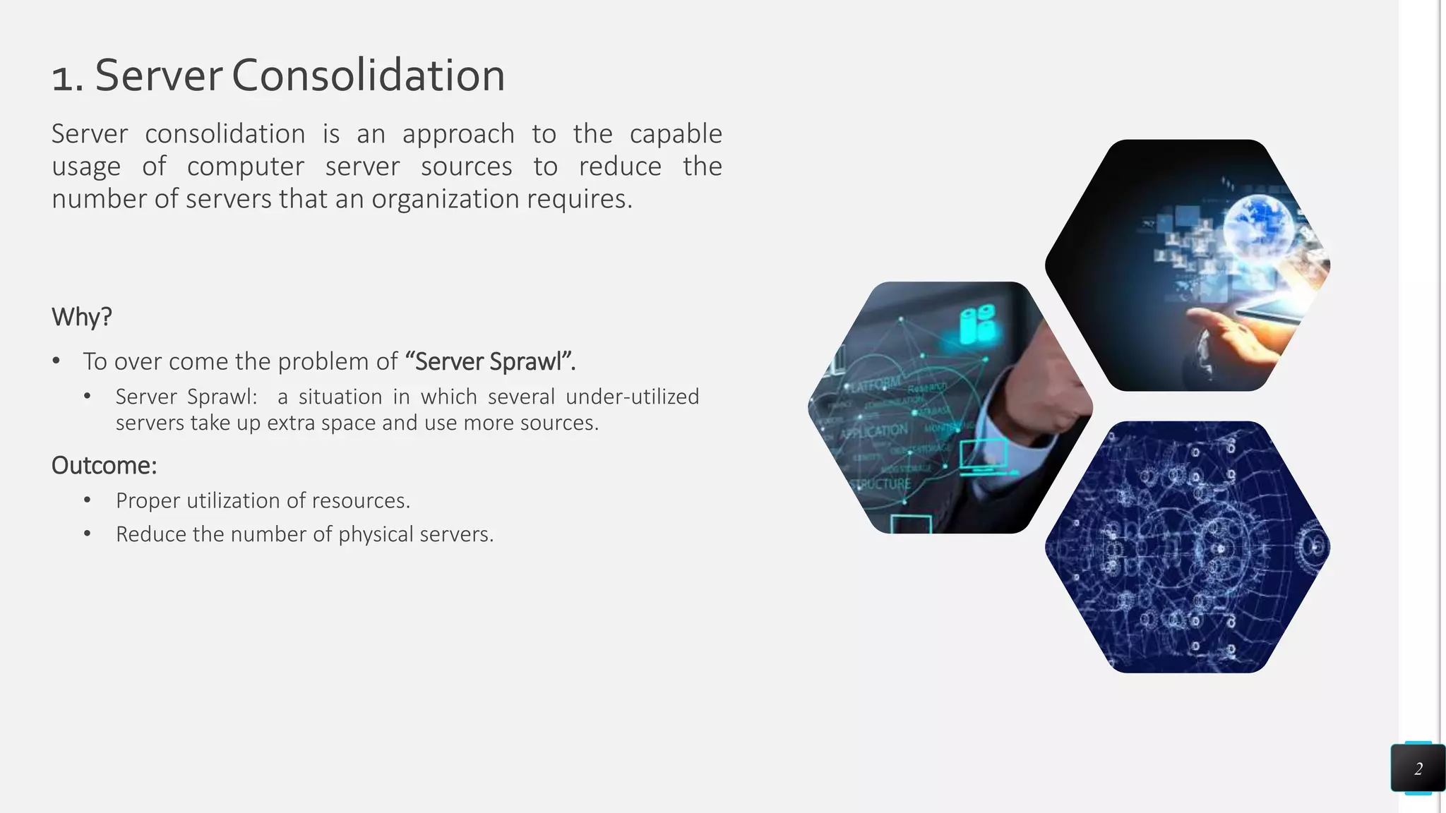
Principles of Virtualization
Understanding Virtualization
Virtualization Uses:

Slide 24
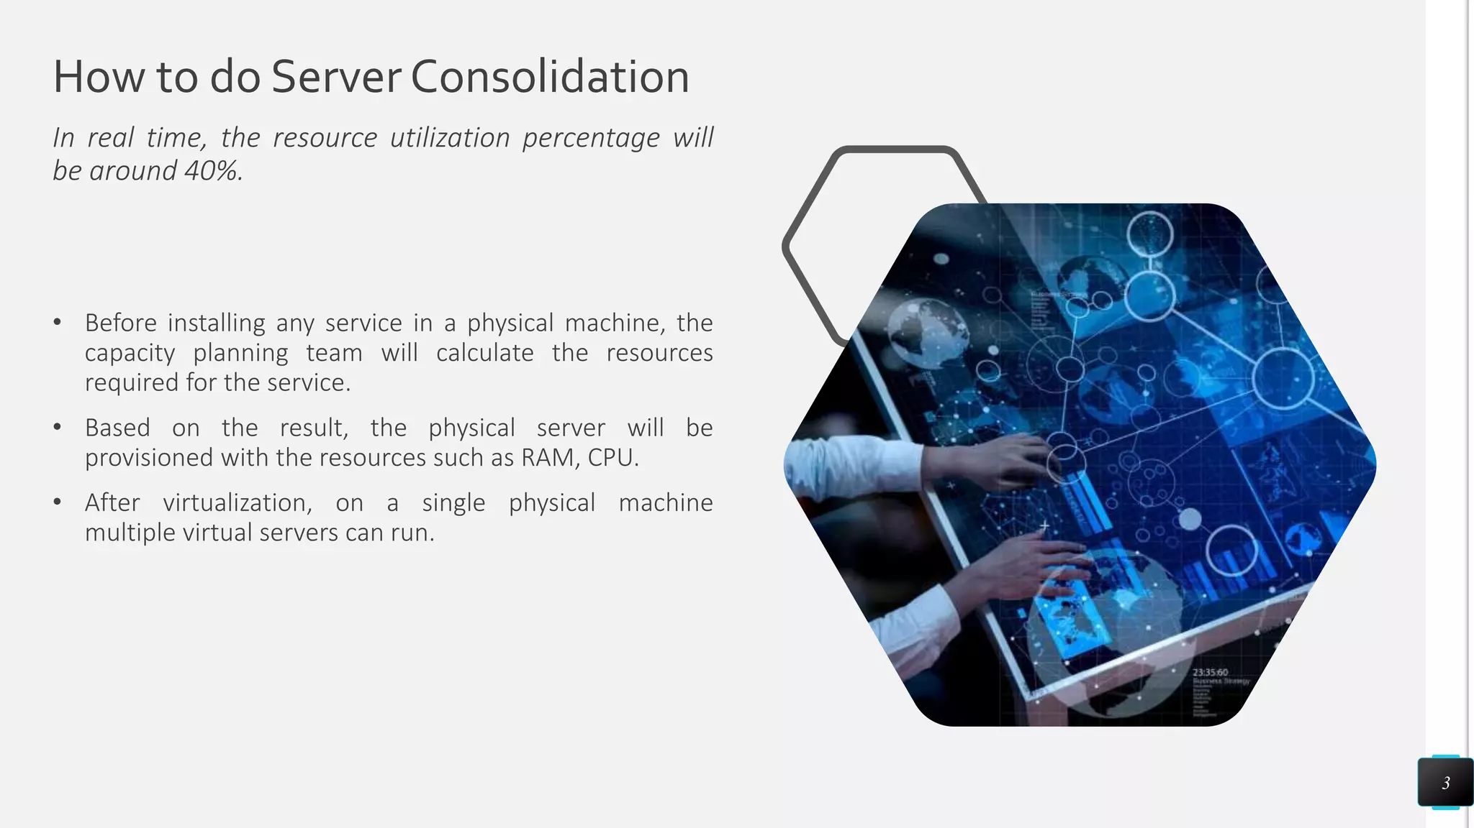
Principles of Virtualization
Understanding Virtualization
Virtualization Uses:

Slide 25
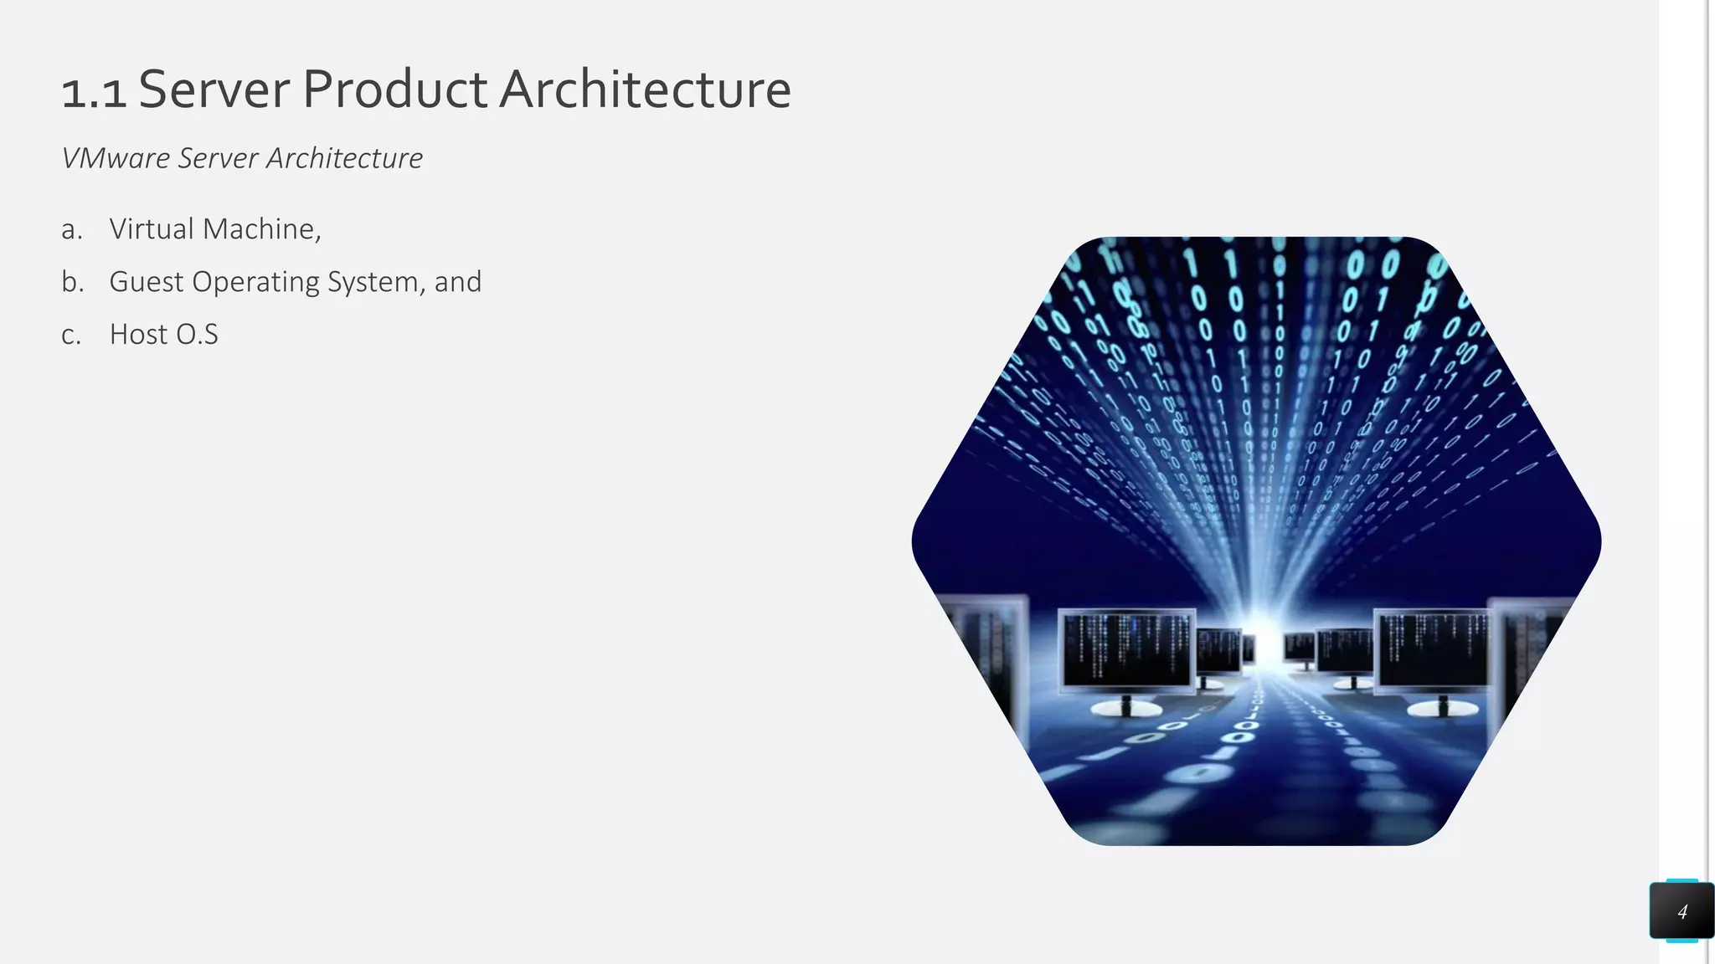
Principles of Virtualization
Understanding Virtualization
Virtualization Uses:

Slide 26
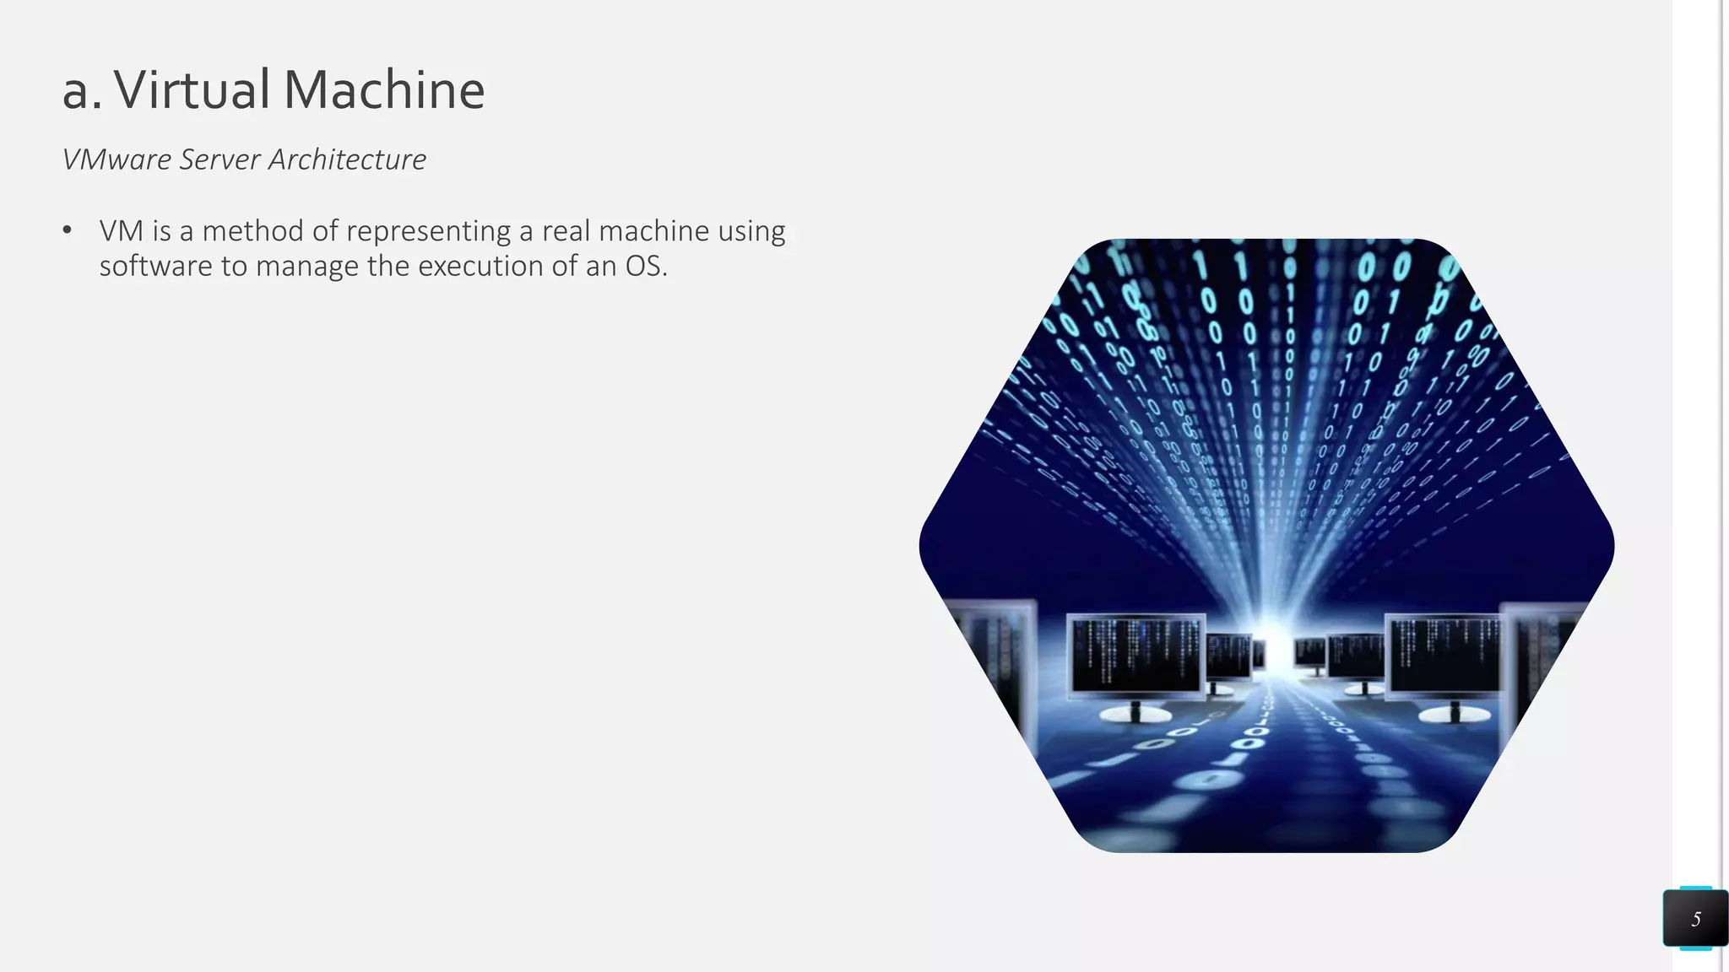
Principles of Virtualization
Understanding Virtualization
Virtualization Uses:

Slide 27
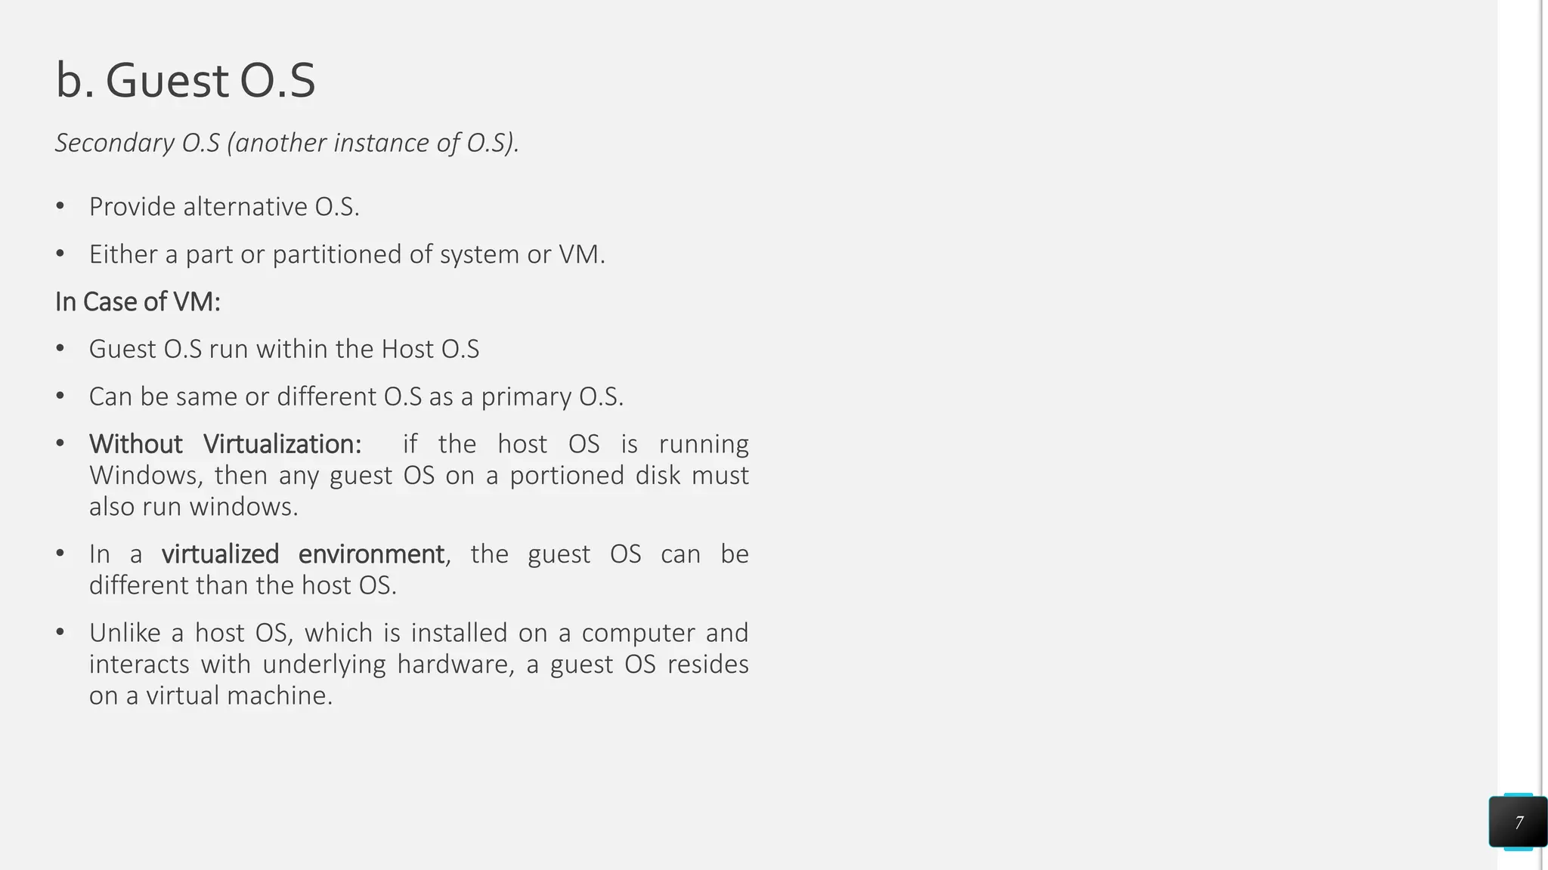
Principles of Virtualization
Understanding Virtualization
Virtualization Uses:

Slide 28
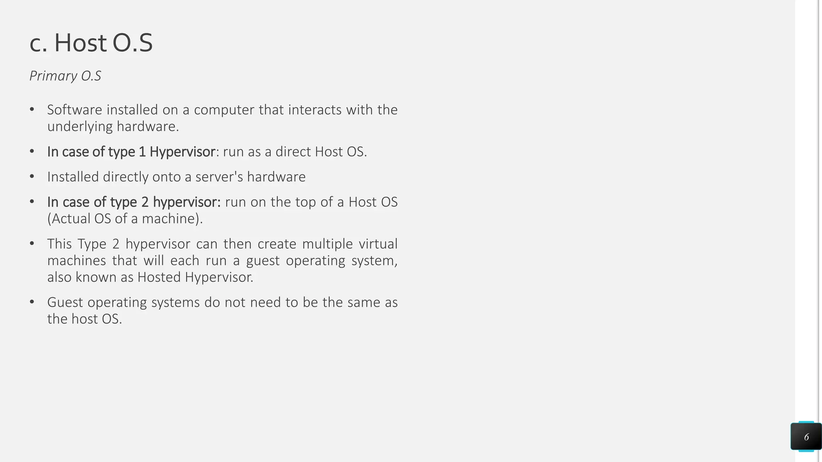
Principles of Virtualization
Understanding Virtualization
Virtualization Uses:

Slide 29
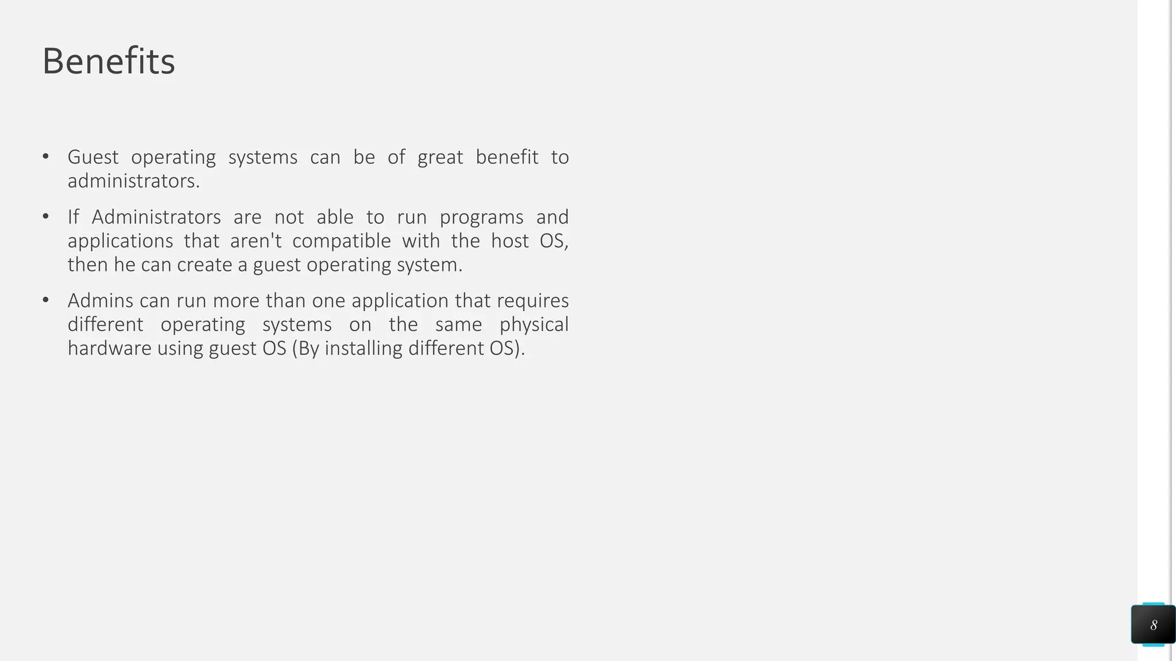
Principles of Virtualization
Understanding Virtualization
Virtualization Uses:

Slide 30
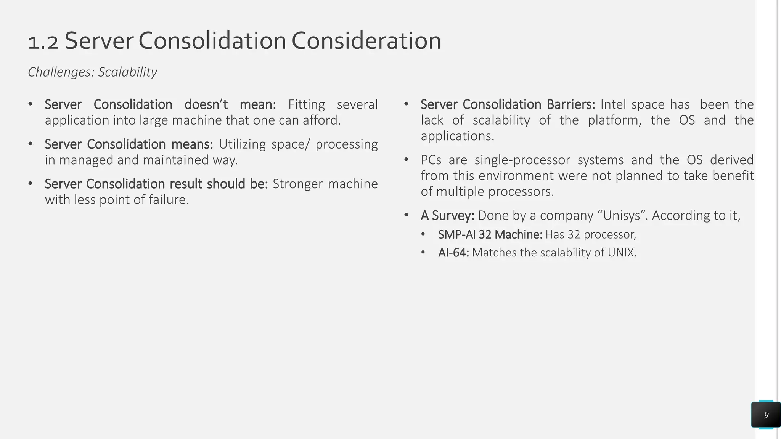
Principles of Virtualization
Understanding Virtualization
Virtualization Uses:

Slide 31
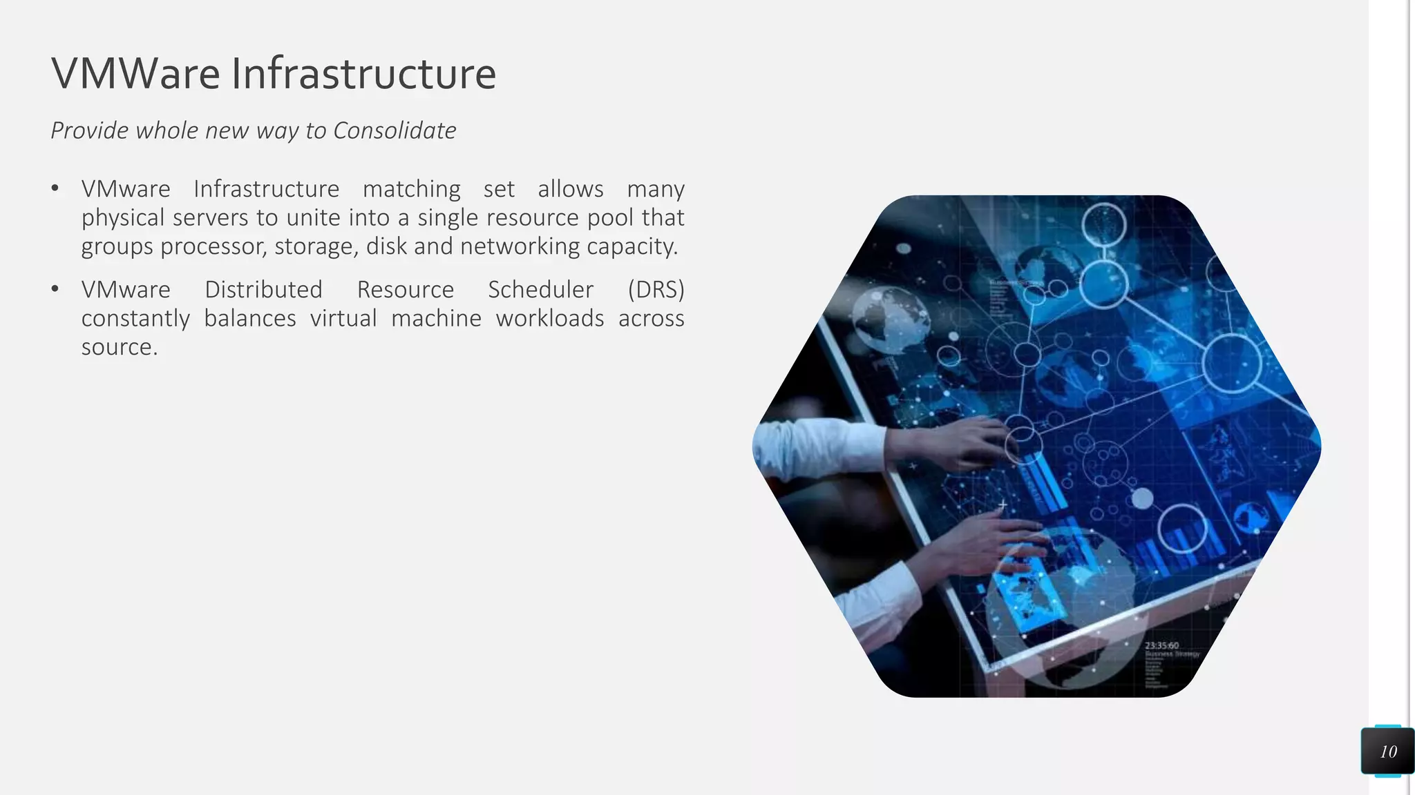
Principles of Virtualization
Understanding Virtualization
Virtualization Uses:

Slide 32
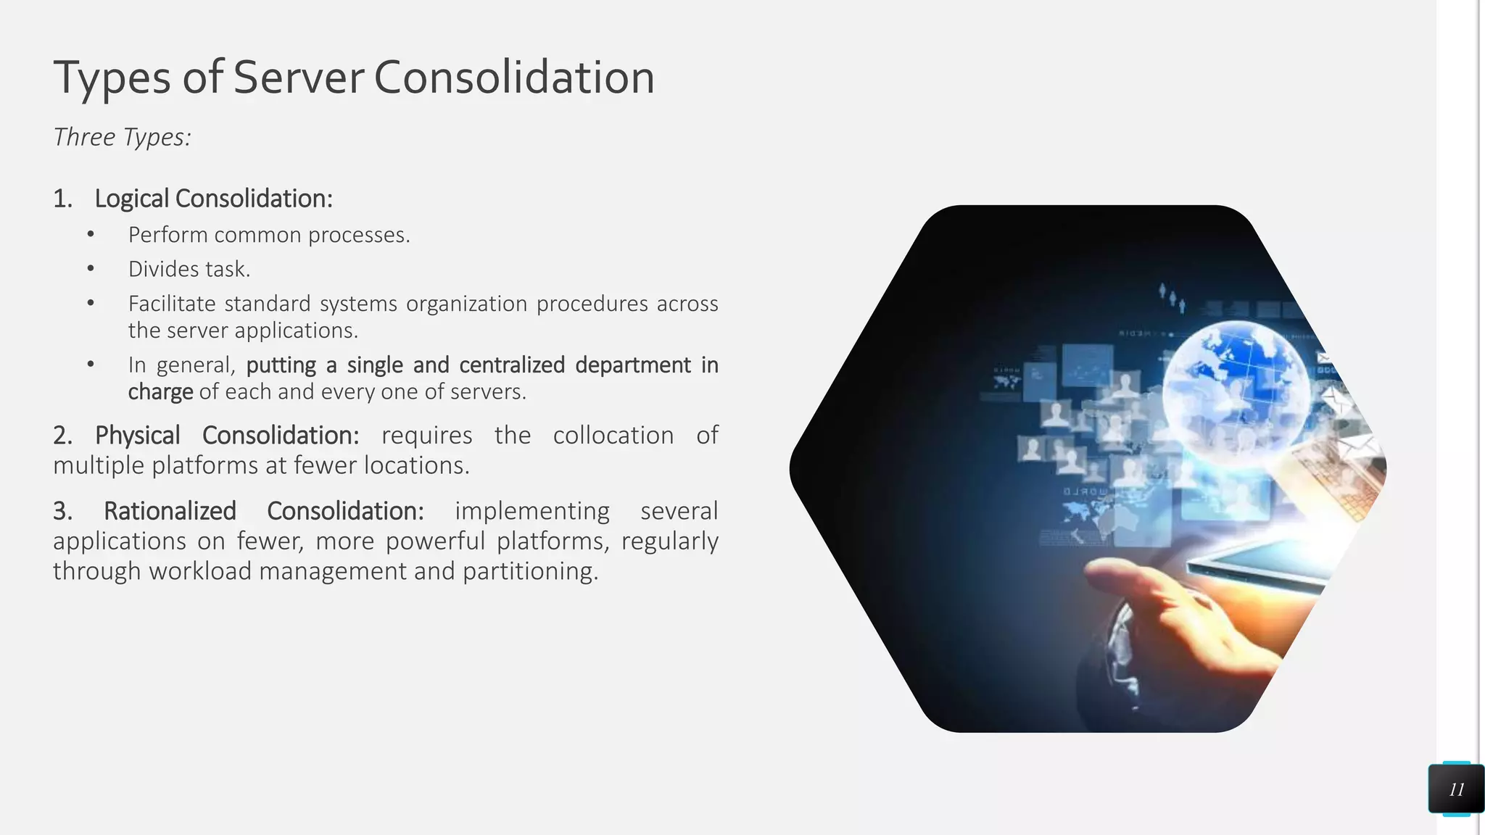
Principles of Virtualization
Understanding Virtualization
Virtualization Uses:

Slide 33
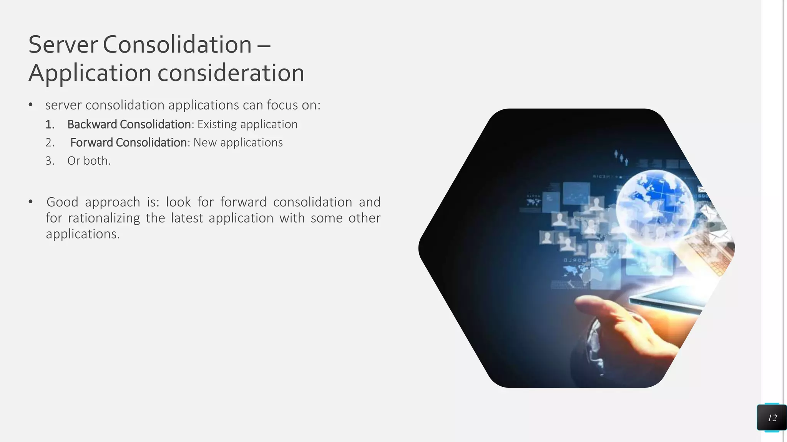
Principles of Virtualization
Understanding Virtualization
Virtualization Uses:

Slide 34
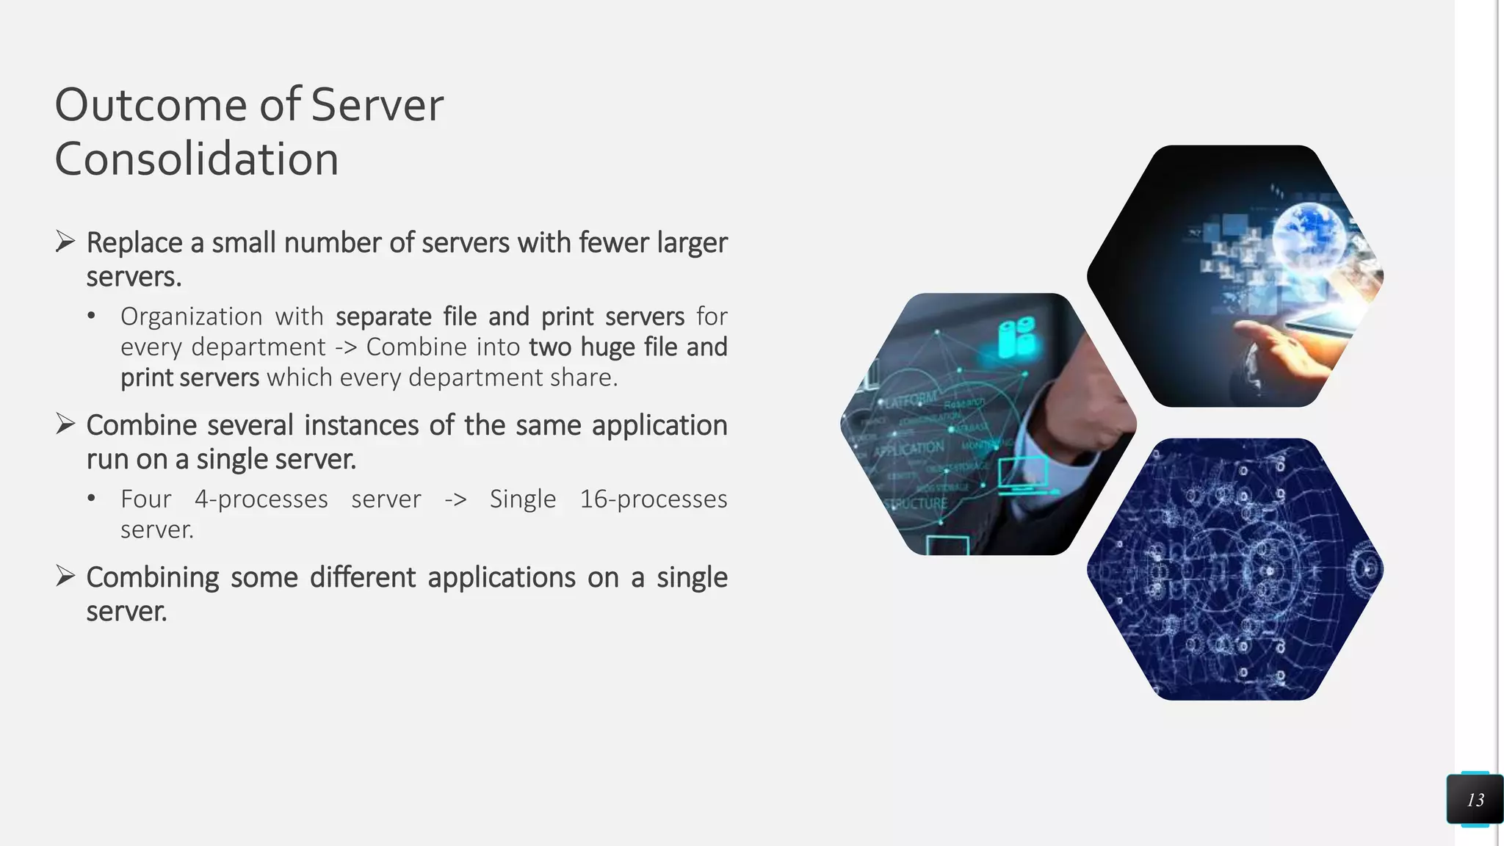
Principles of Virtualization
Understanding Virtualization
Virtualization Uses:

Slide 35
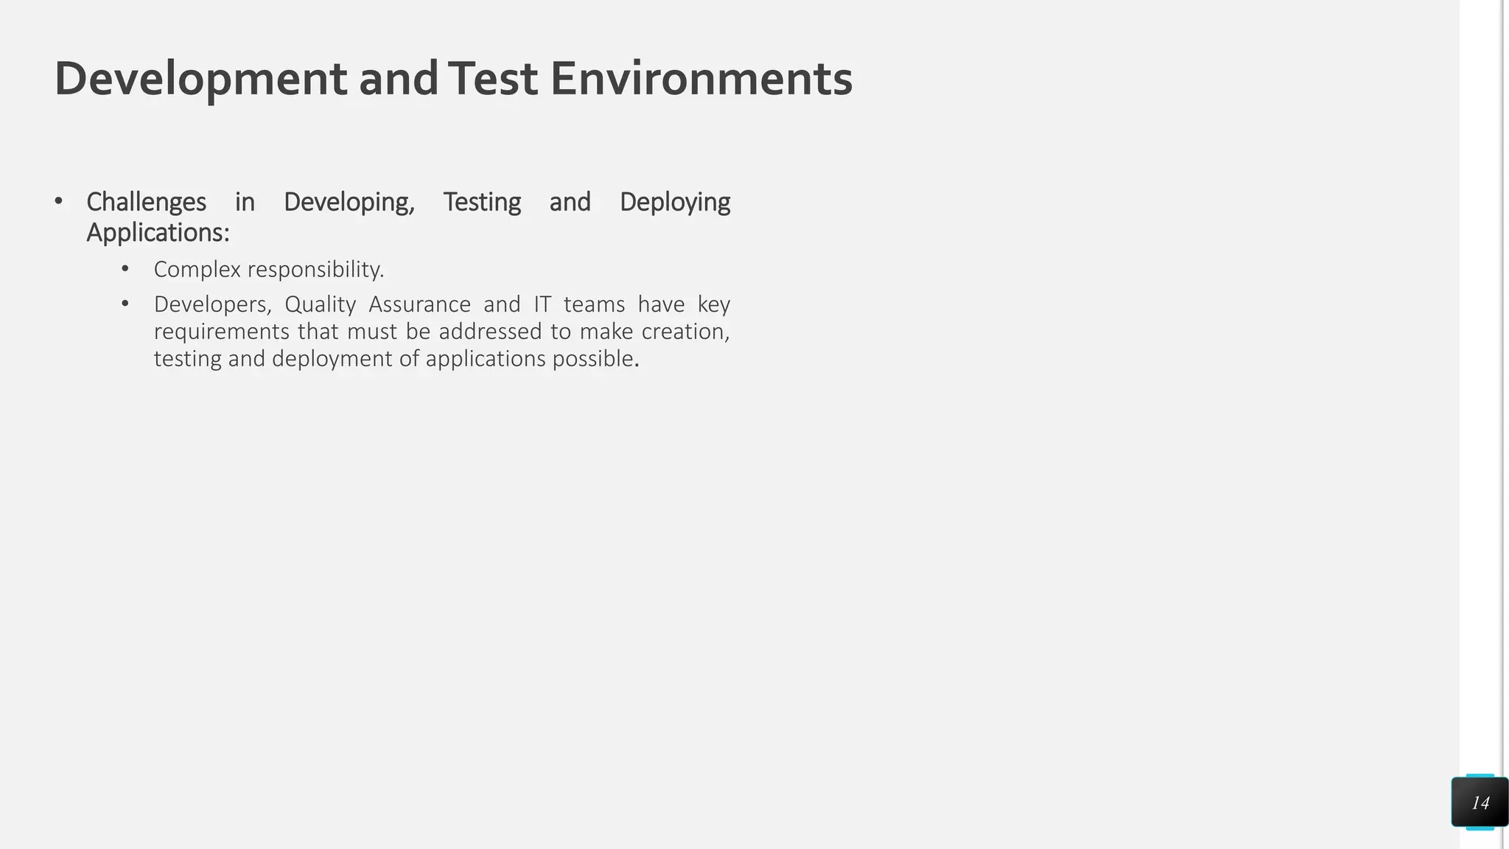
Principles of Virtualization
Understanding Virtualization
Virtualization Uses:

Slide 36
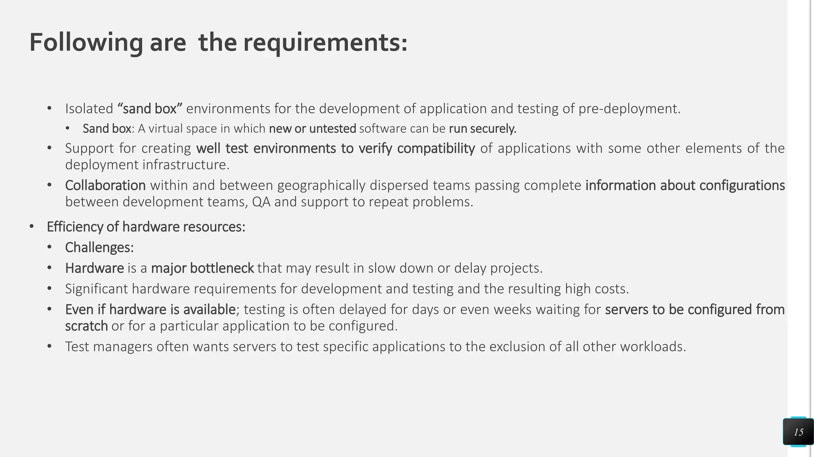
Principles of Virtualization
Understanding Virtualization
Virtualization Uses:

Slide 37
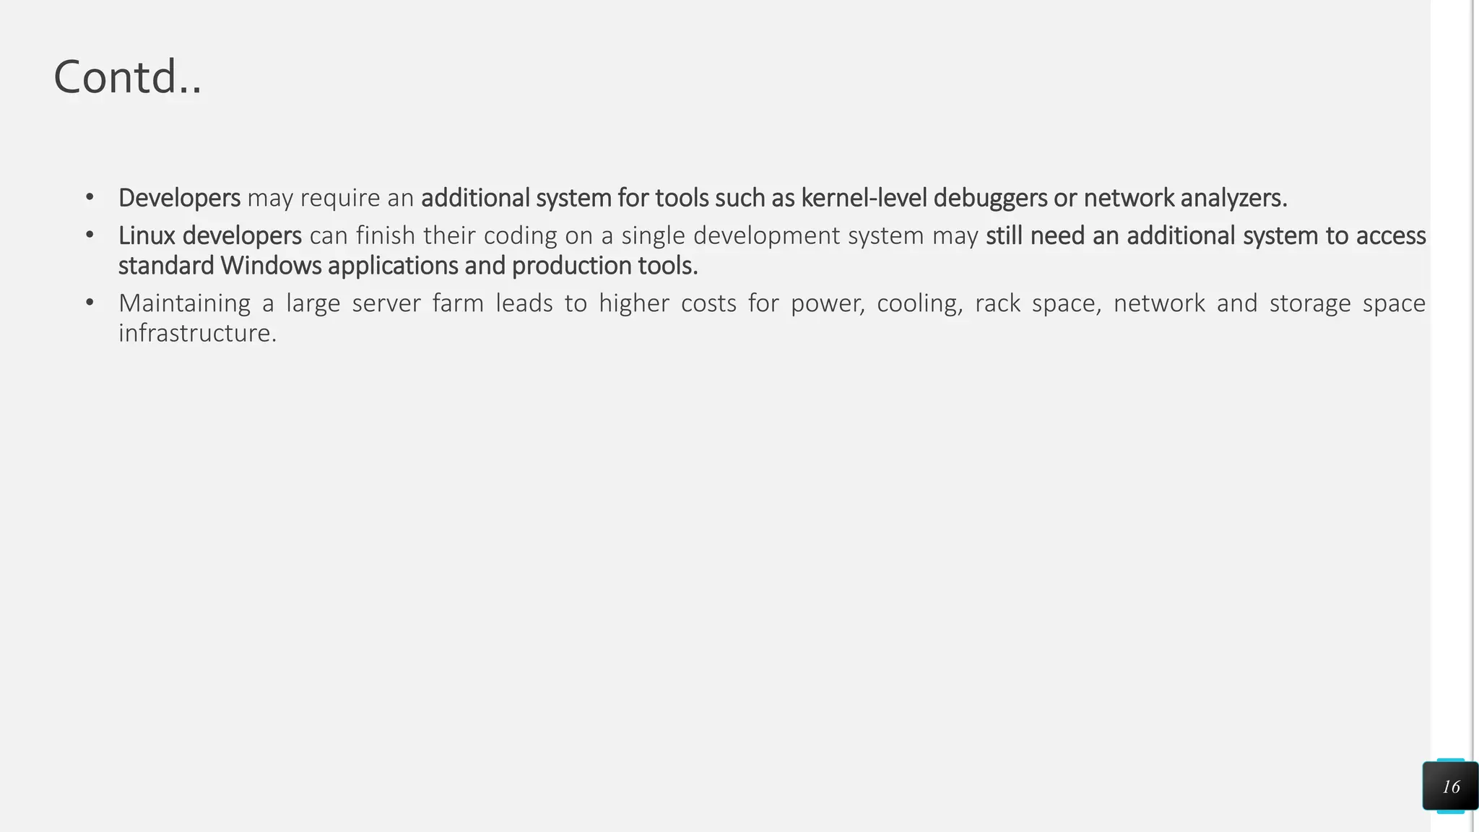
Principles of Virtualization
Understanding Virtualization
Virtualization Uses:

Slide 38
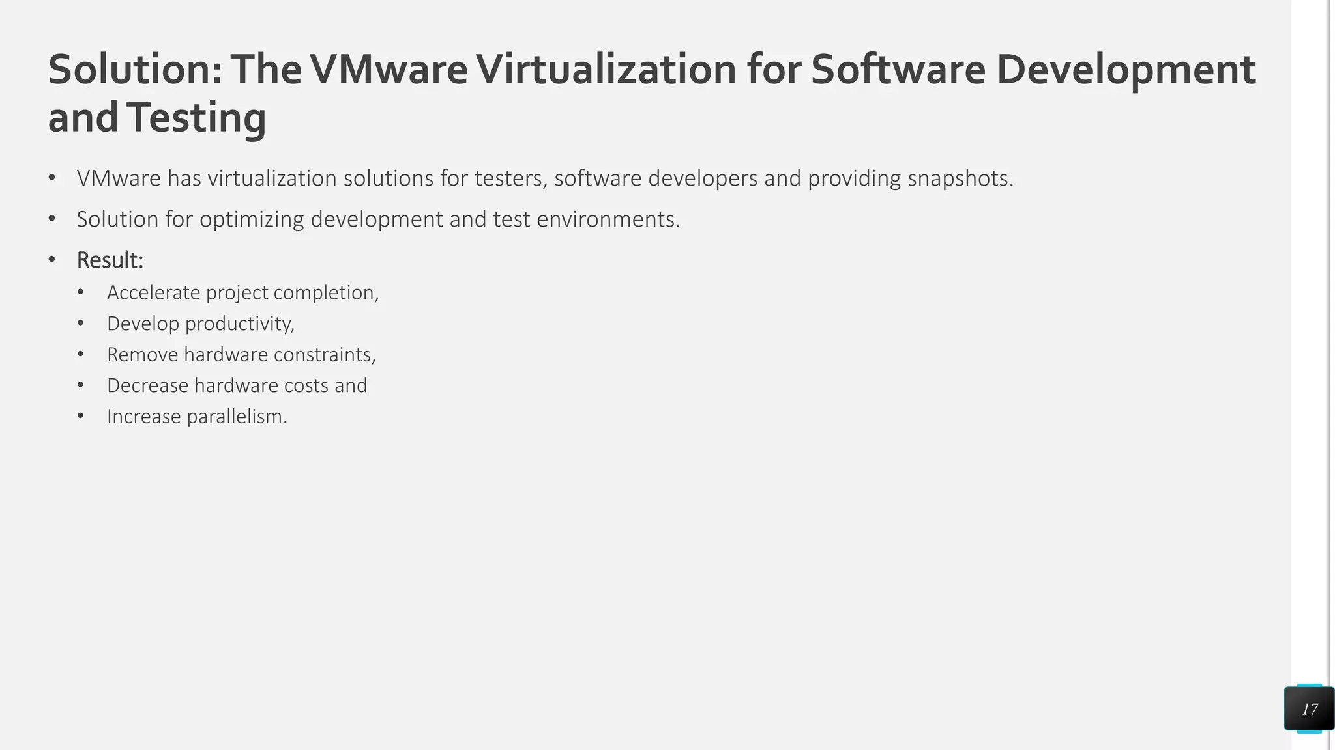
Principles of Virtualization
Understanding Virtualization
Virtualization Uses:

Slide 39
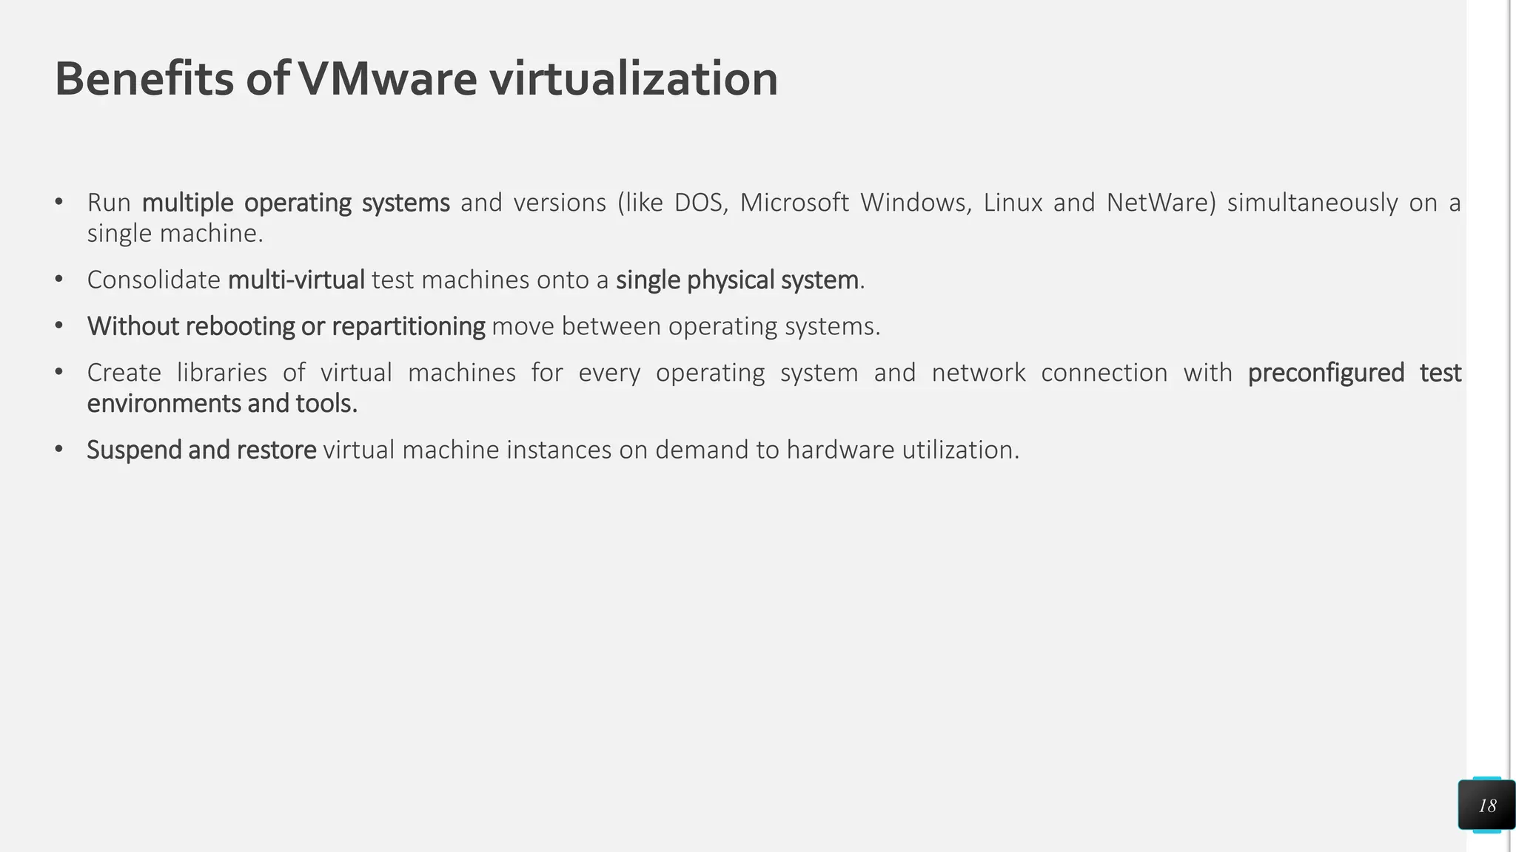
Principles of Virtualization
Understanding Virtualization
Virtualization Uses:

Slide 40
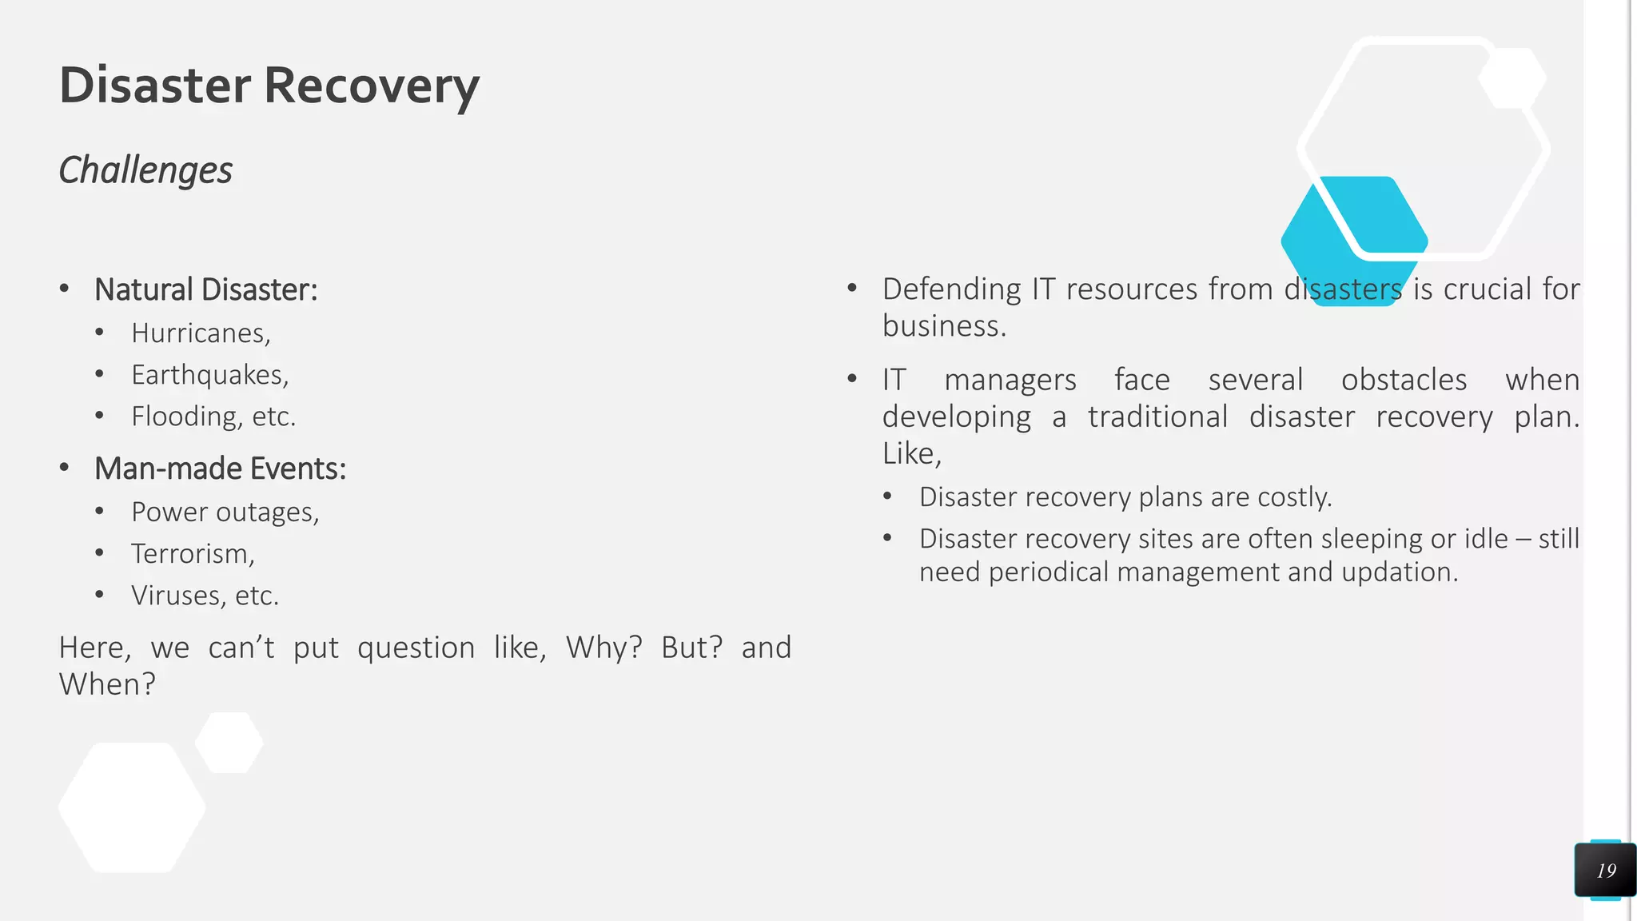
Principles of Virtualization
Understanding Virtualization
Virtualization Uses:

Slide 41
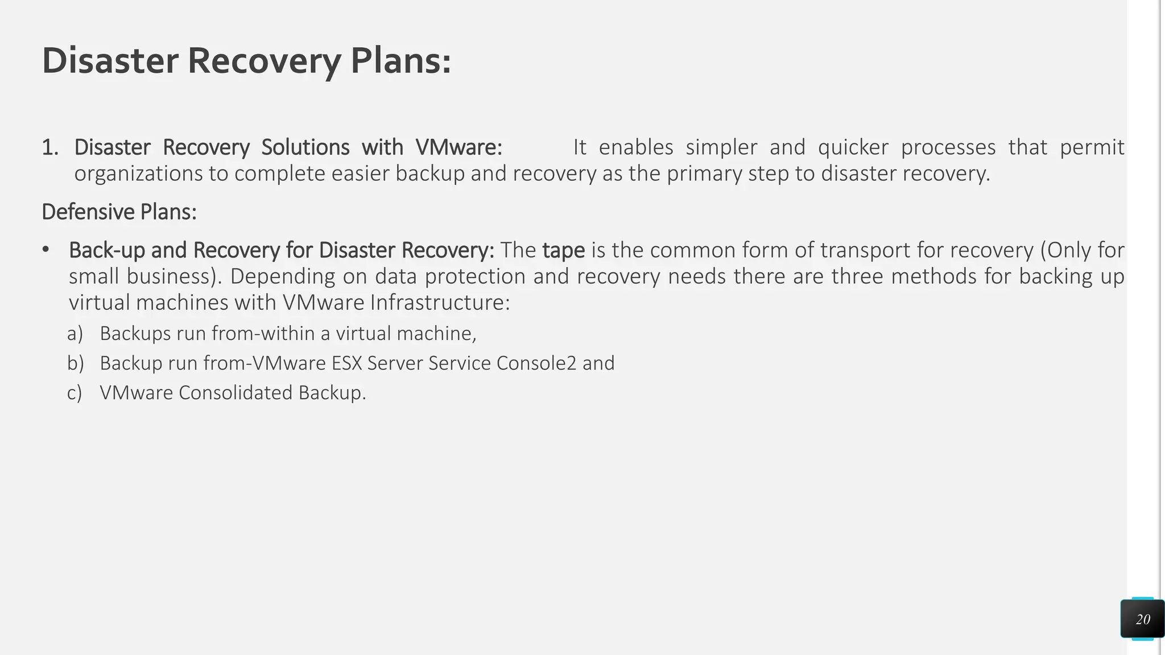
Principles of Virtualization
Understanding Virtualization
Virtualization Uses:

Slide 42
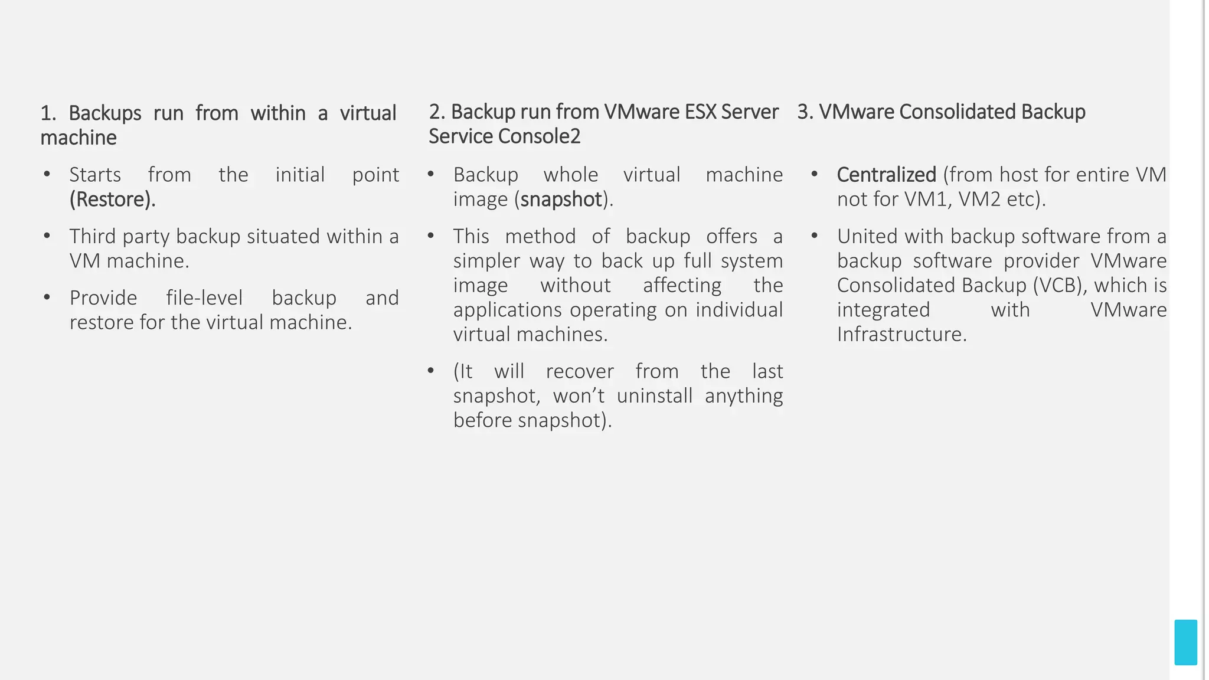
Principles of Virtualization
Understanding Virtualization
Virtualization Uses:

Slide 43
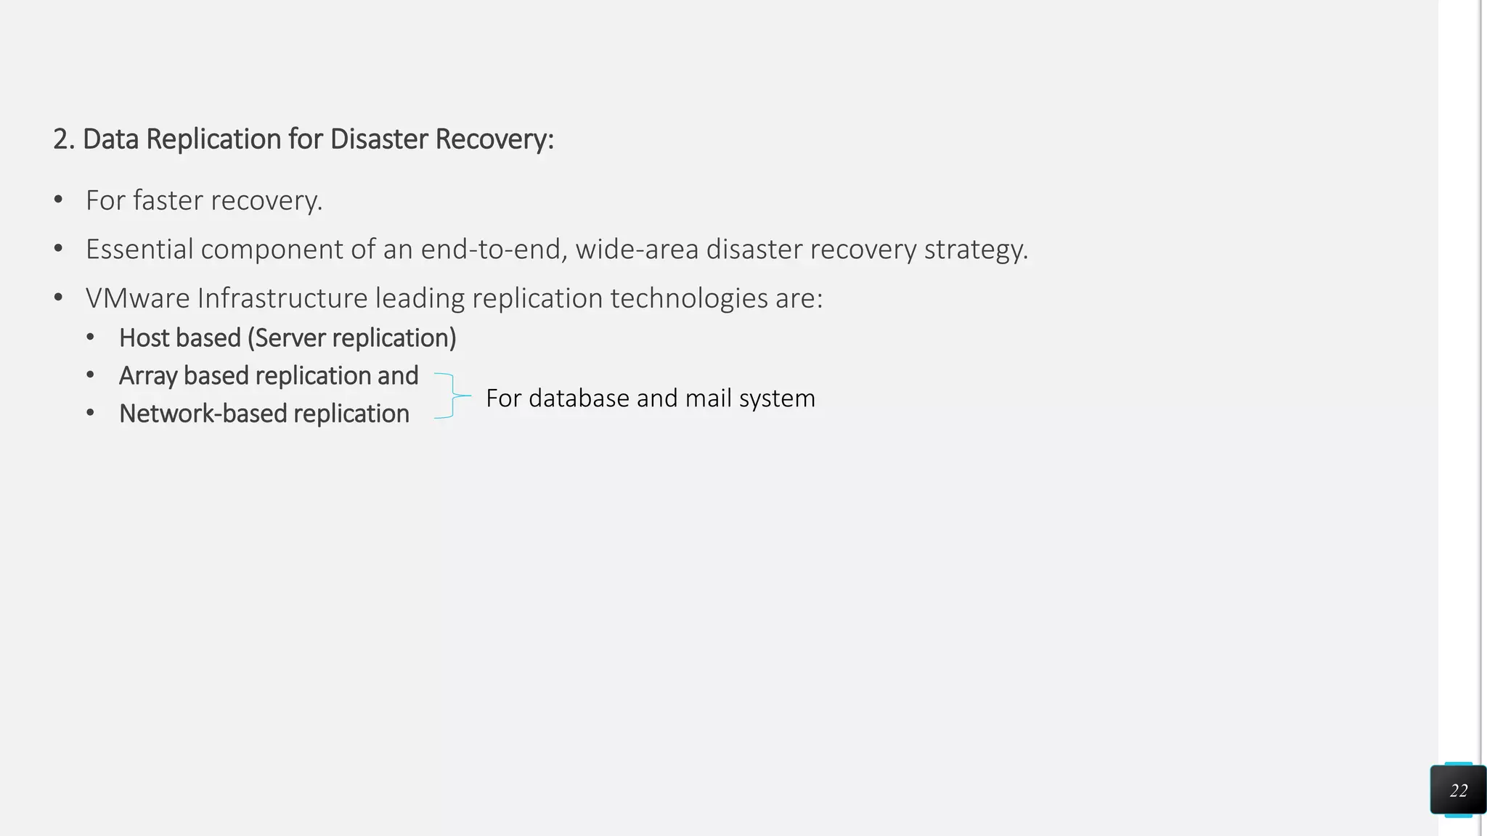
Principles of Virtualization
Understanding Virtualization
Virtualization Uses:

Slide 44
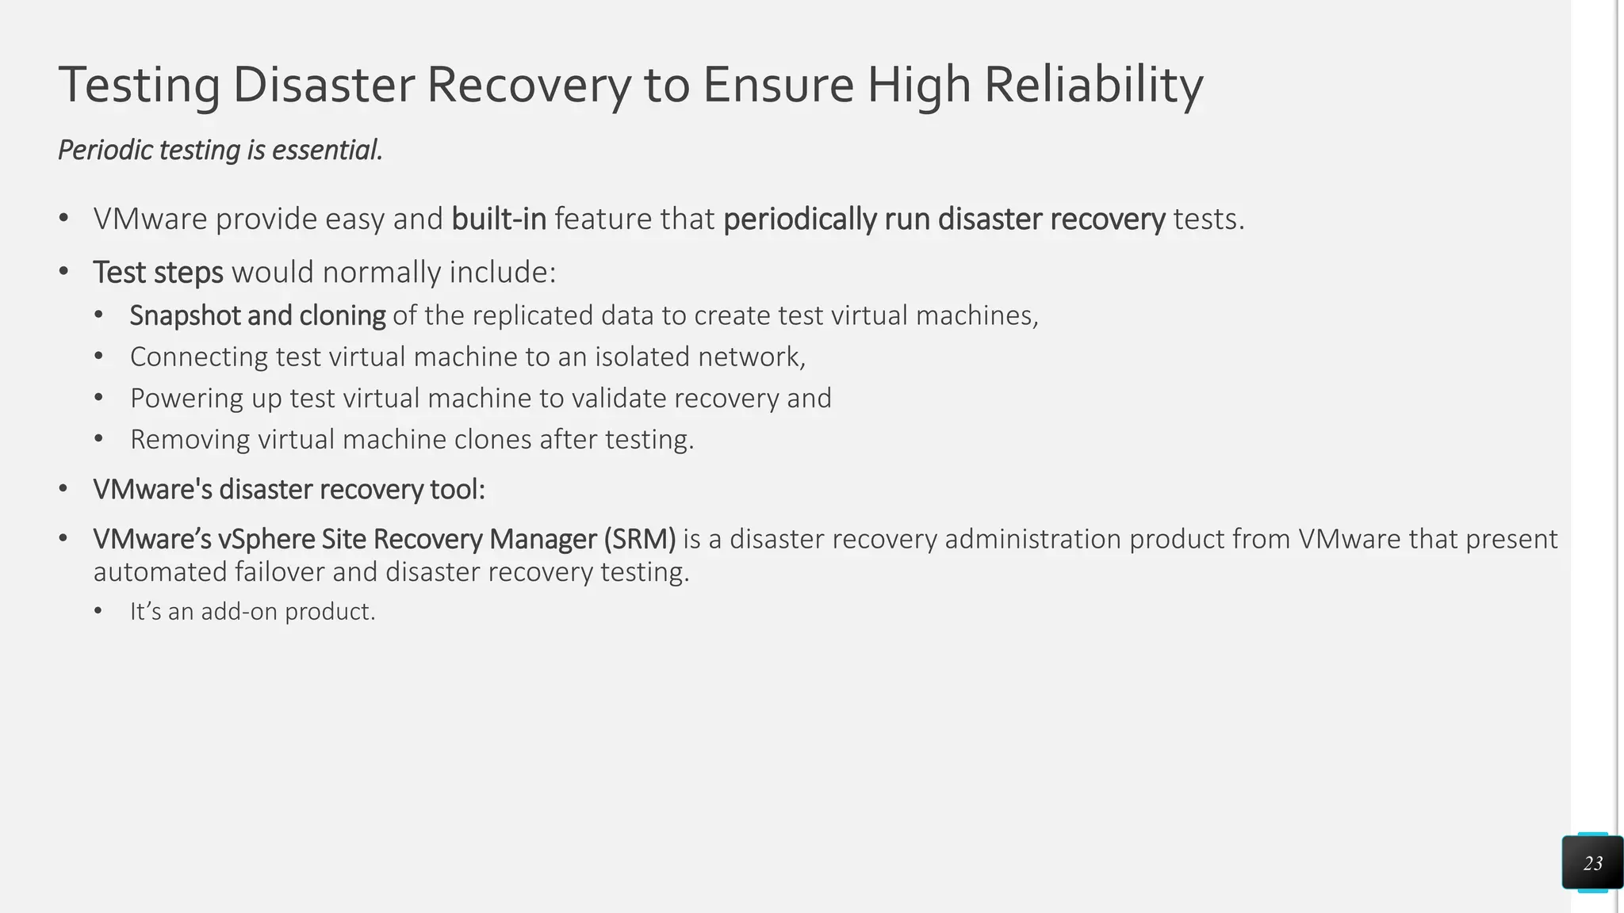
Principles of Virtualization
Understanding Virtualization
Virtualization Uses:

Slide 45
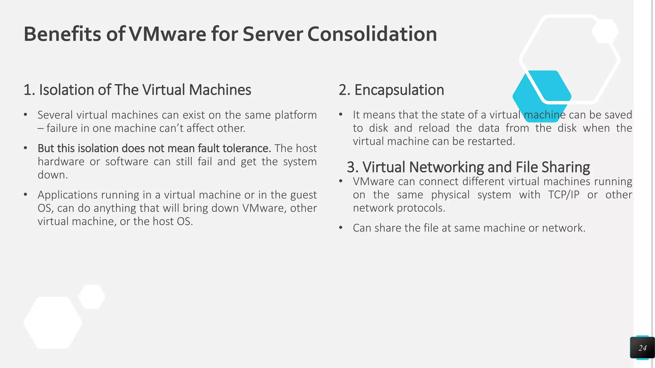
Principles of Virtualization
Understanding Virtualization
Virtualization Uses:

Slide 46
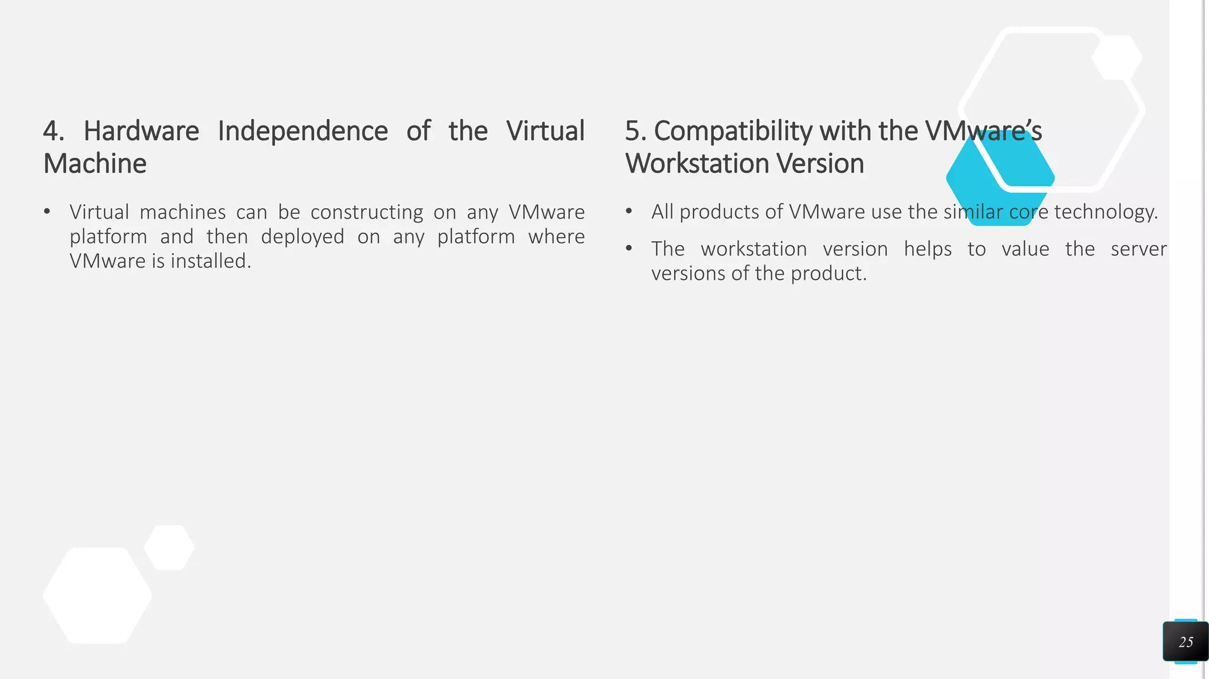
Principles of Virtualization
Understanding Virtualization
Virtualization Uses:

Slide 47
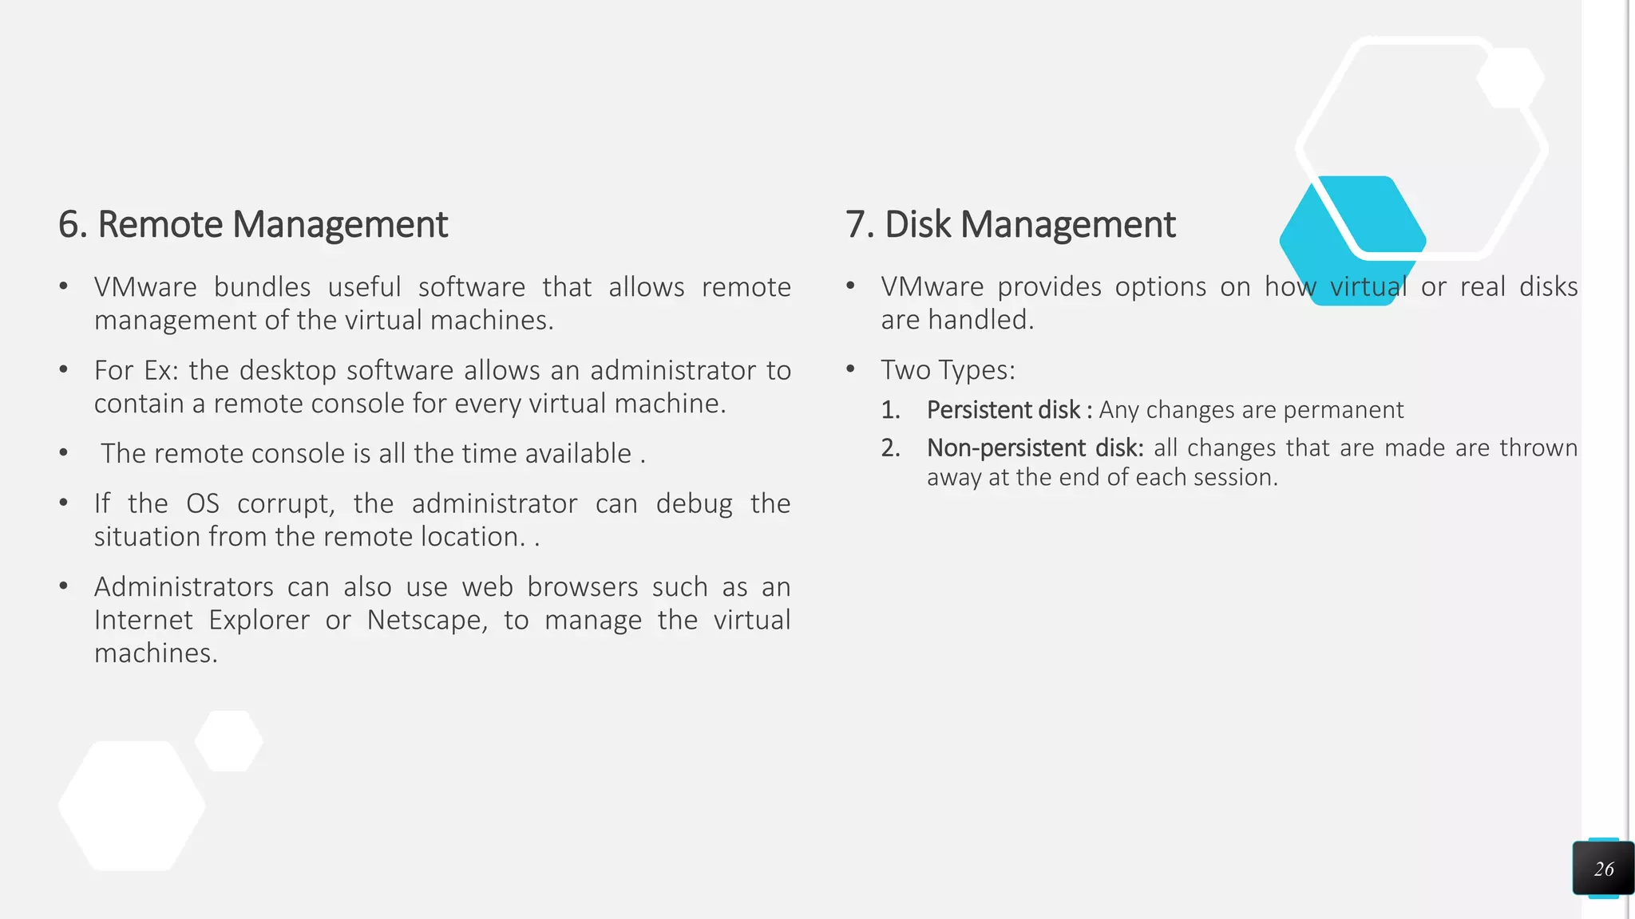
Principles of Virtualization
Understanding Virtualization
Virtualization Uses:

Slide 48
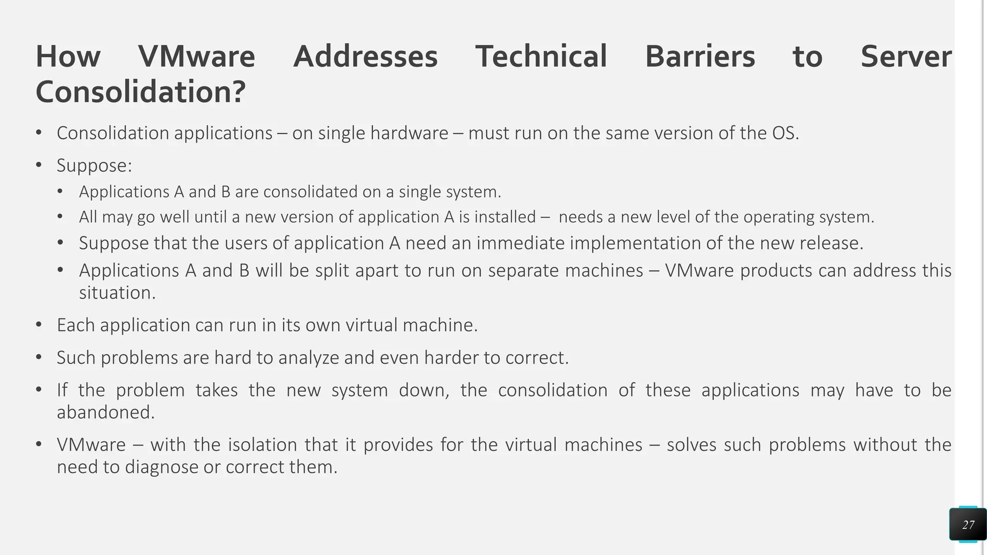
Principles of Virtualization
Understanding Virtualization
Virtualization Uses:

Slide 49
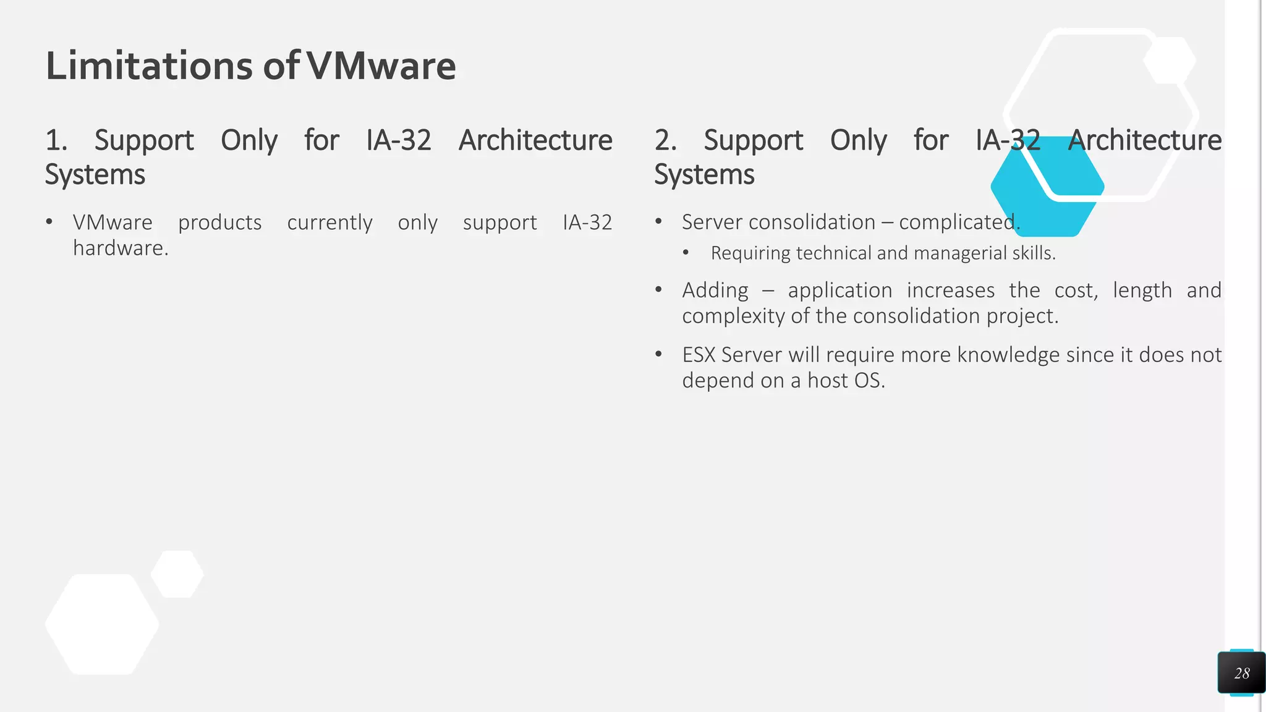
Principles of Virtualization
Understanding Virtualization
Virtualization Uses:

Slide 50
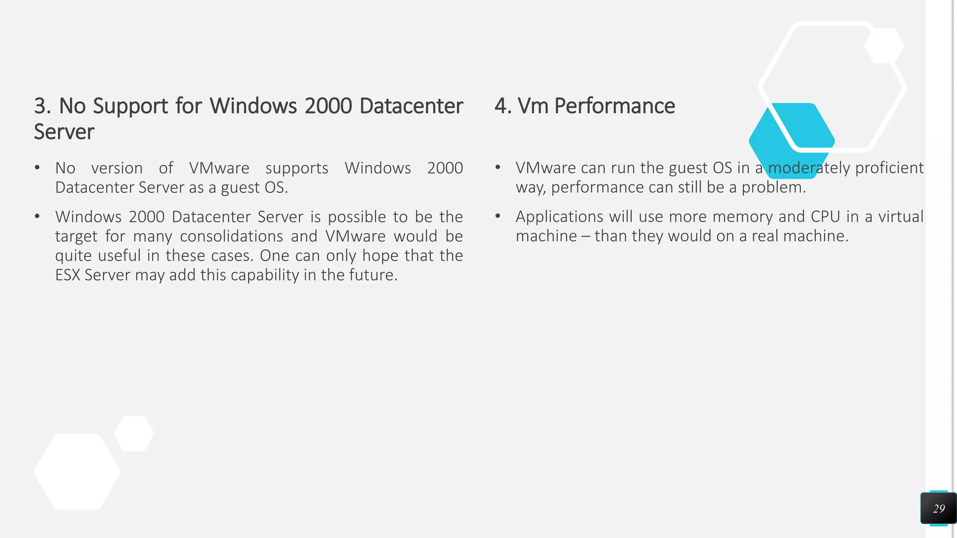
Principles of Virtualization
Understanding Virtualization
Virtualization Uses:

Slide 51
Keep Learning
Thank You!

